Slide 1
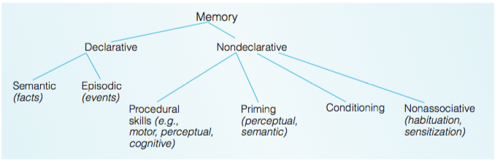
Multiple memory systems

Slide 2
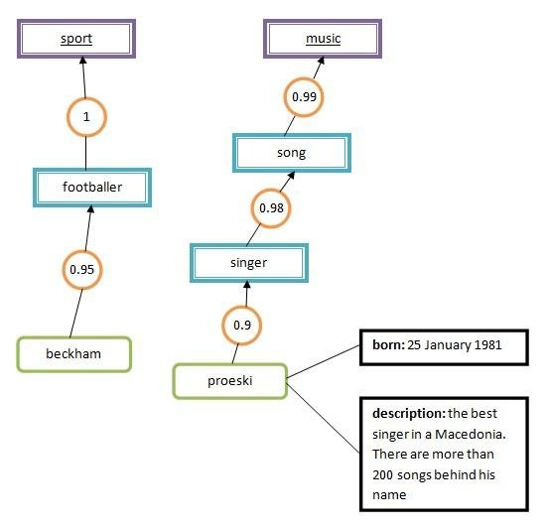

Slide 3
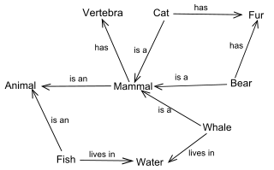
Declarative memory; Semantic

Slide 4
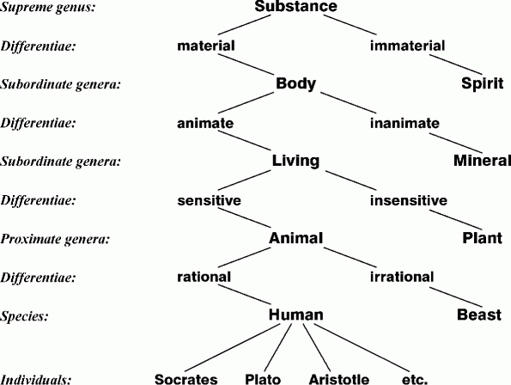
Declarative memory; Semantic

Slide 5
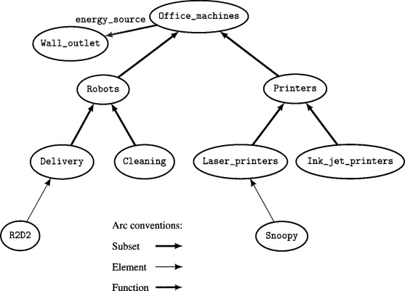
Declarative memory; Semantic

Slide 6
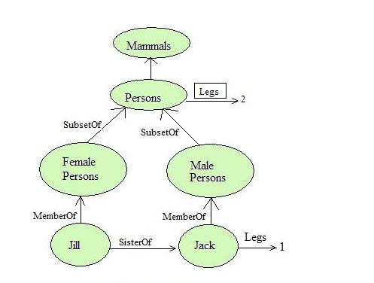
Declarative memory; Semantic

Slide 7
Retrieval from long term
Clothing
  Shorts
  Pant
  Shirt
  Belt
  Socks
Transport
  Trains
  Bus
  Caravan
  Ship
Recall all words (freely)
vs
Recall specific subset (with cue like clothing)

Slide 8
What is to be measured?
Availability in memory (presence)
Vs
Accessibility (gain access to available info)

Slide 9
Why do we forget?
Interference
vs
Decay

Slide 10
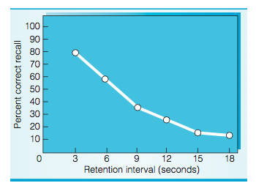
Interference theory
  Trigrams (strings of 3 characters which cannot be easily pronounced like KBF) presented and asked to recall after 3,6,9,12,15, 18 seconds
  More so if retention interval is blocked

Slide 11
Interference
The idea of domain specificity does not hold –
  (verbal interferes with verbal) or (numeric interferes with numeric): 1960s
Two kinds of interference
  Retroactive [after we learn]
  Proactive [before we learn - info that is already learnt hinders new]

Slide 12
Try this
Remember this set of words:
Anchor. hollow. book, peace, window, run, box, harmony, hat, voice, tree, begin, anchor, hollow, floor, area, tomato, concept, arm, rule, lion, hope

Slide 13
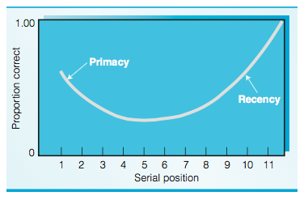
Serial position effect

Slide 14
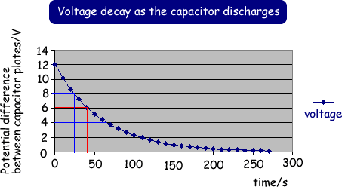
Decay theory
Gradual disappearance (not necessarily displacement)
Accounts for only a small portion of forgetting

Slide 15
Constructive memory
See 28 droodles – label them (group1) or see them (group2)
Middle aged people remember events from early-adult life more than more recent past
Autobiographies are good but often distorted
Daily diary vs long term recall of episodes
Aubiographic forgetting can be linear (not curvilinear, Linton 1982)
Focal remembering, marginal details forgotten

Slide 16
Types of Distortions
Transience (What events happened that day?)
Absent-mindedness (brush again)
Blocking (I know it but its not coming!)
Misattribution (Read on Whatsapp or FB)
Suggestibility (was there a b/w TV?)
Bias (under pain, life is painful)
Persistence (failed once)

Slide 17
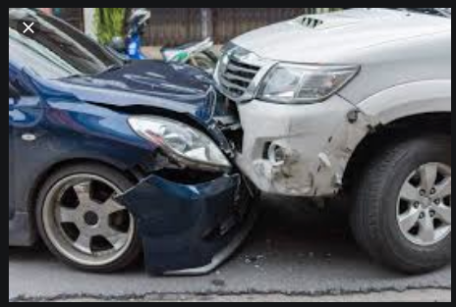
A car accident

Slide 18
Eyewitness testimony
Upto 90% wrong convictions in US (Wells, ‘93)
A powerful determinant of a sentence
What influences accuracy? (Loftus)
  Perceptual details
  Imagined episodes
  Preset judgmental bias
  Anxiety
  Questions and Interogator

Slide 19
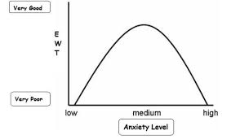
Eye witness memory

Slide 20
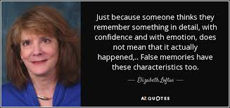
https://www.ted.com/talks/elizabeth_loftus_the_fiction_of_memory

Slide 21
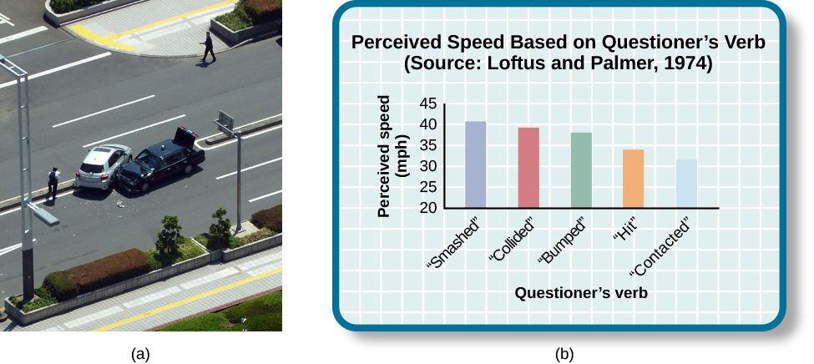

Slide 22
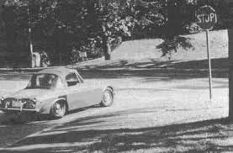
Datsun study

Slide 23
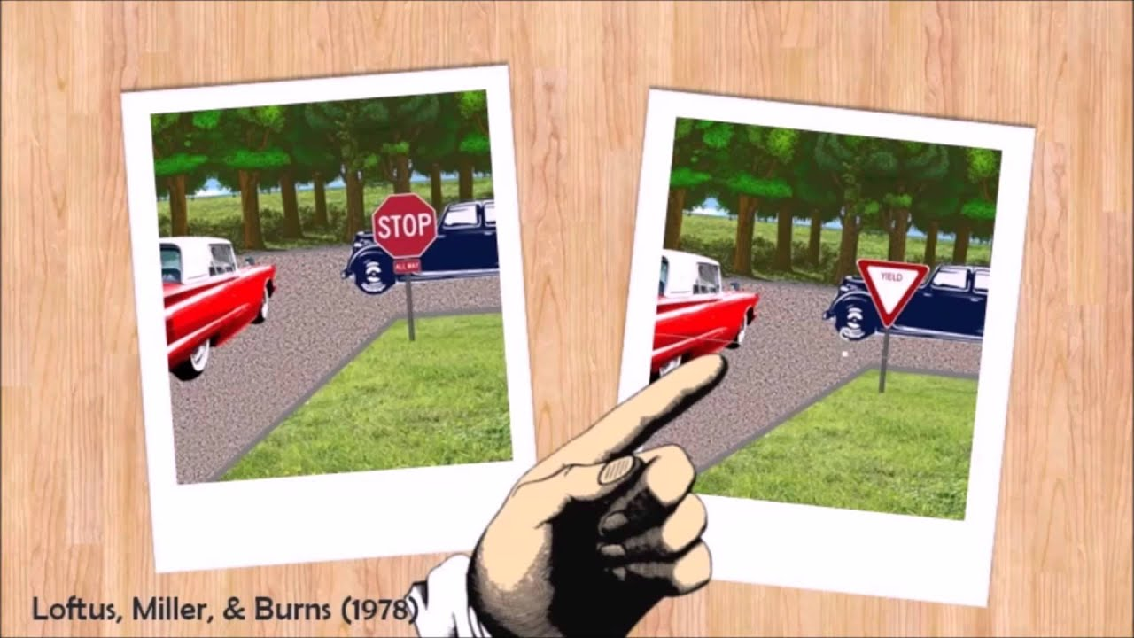
Misinformation effect

Slide 24
